Slide 1
Intermediate Coding Week 4
Classes

Slide 2
It is time…to finally understand what all that class Main stuff is about

Slide 3

Classes

Slide 4
A programming problem
Imagine you are running a virtual pet store and you want to keep track of all of your virtual dogs.
For example, you could have a 5-year-old Dalmatian named Anita, a 3-year-old Spaniel named Lady, and a 2-year-old Golden Retriever named Dug.

Slide 5
A bad solution
String dog1Name = “Anita”;
String dog2Name = “Lady”;
String dog3Name = “Dug”;
int dog1Age = 5;
int dog2Age = 3;
int dog3Age = 2;
String dog1Breed = “Dalmatian”;
String dog2Breed = “Spaniel”;
String dog3Breed = “Golden Retriever”;
You could make individual variables for each attribute of each dog, but it would be confusing, and you wouldn’t be able to control how many dogs there were.

Slide 6
Another bad solution
String[] names = {“Anita”, “Lady”, “Dug”};
int[] ages = {5, 3, 2};
String[] breeds = {“Dalmatian”, “Spaniel”, “Golden Retriever”};
You could put the dogs in an array, but it would still be inconvenient to talk about individual dogs.
Instead, we can group the variables together as a class.

Slide 7
Classes and objects
class: A program entity that represents either:
1. A program / module, or
2. A template for a new type of objects.
The Scanner class is a template for creating Scanner objects.
object: An entity that combines state and behavior.
object-oriented programming (OOP): Programs that perform their behavior as interactions between objects.

Slide 8
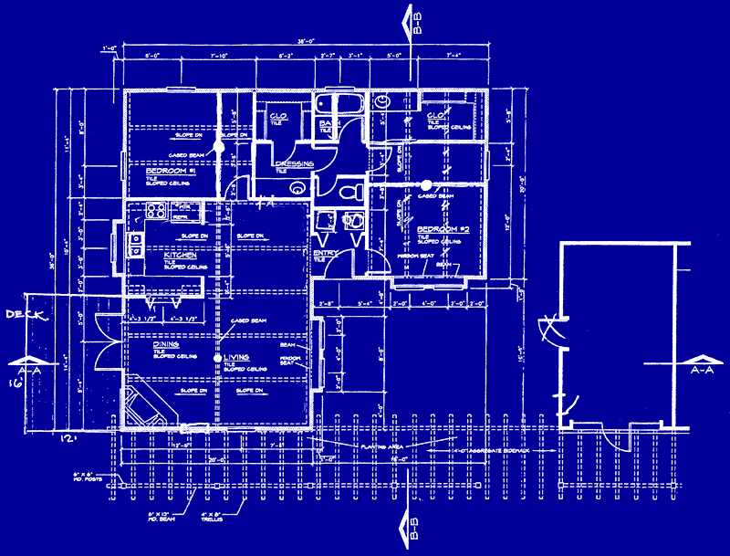
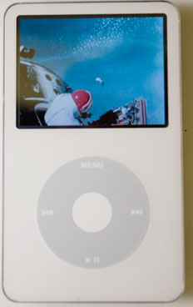
Blueprint analogy
iPod blueprint
state: current song volume battery life
behavior: power on/off change station/song change volume choose random song
creates
iPod #1
state: song = "1,000,000 Miles" volume = 17 battery life = 2.5 hrs
behavior: power on/off change station/song change volume choose random song
iPod #2
state: song = "Letting You" volume = 9 battery life = 3.41 hrs
behavior: power on/off change station/song change volume choose random song
iPod #3
state: song = "Discipline" volume = 24 battery life = 1.8 hrs
behavior: power on/off change station/song change volume choose random song

Slide 9
Applying the Class Blueprint
The state of a Dog object would be its name, breed, and age.
The behavior of a Dog could be to bark, sleep, and eat.
In the following slides, we will implement a Dog class as a way of learning about defining classes.
We will define a type of objects named Dog.
Each Dog object will contain data called fields.
Each Dog object will contain behavior called methods.
Client programs will use the Dog objects.
client program: A program that uses objects.
Example: our previous programs have been clients of the Scanner class.

Slide 10
Dog class as blueprint
The class (blueprint) will describe how to create objects.
Each object will contain its own data and methods.
Dog class
state: String name, breed
int age
behavior: bark()
sleep()
eat()
Dog object #1
state: name = “Anita”, breed = “Dalmatian”
age = 5
behavior: bark()
sleep()
eat()
Dog object #2
state: name = “Lady”, breed = “Spaniel”
age = 3
behavior: bark()
sleep()
eat()

Slide 11
Object state: Fields

Slide 12
Dog class, version 1
public class Dog {
String name;
String breed;
int age;
}
The above code creates a new type named Dog.
Each Dog object contains three pieces of data:
A String named name,
A String named breed,
An int named age.
Dog objects do not contain any behavior (yet).

Slide 13
Fields
field: A variable inside an object that is part of its state.
Each object has its own copy of each field.
Declaration syntax:
type name;
Example:
public class Student {
String name; // each Student object has a
int age; // name and age field
}

Slide 14
Accessing fields
Other classes can access/modify an object's fields.
access: variable.field
modify: variable.field = value;
Example:
Dog d = new Dog();
System.out.println("the name is " + d.name); // access
d.age = 5; // modify

Slide 15
A class and its client
Dog.java is not, by itself, a runnable program.
A class can be used by client programs.
PetStoreMain.java (client program)
public class PetStoreMain {
public static void main(String args) {
Dog d1 = new Dog();
d1.name = “Anita”;
d1.breed = “Dalmatian”;
d1.age = 5;
Dog d2 = new Dog();
d2.name = “Lady”;
d2.breed = “Spaniel”;
d2.age = 3;
...
}
}
Dog.java (class of objects)
public class Dog {
String name;
String breed;
int age;
}

Slide 16
Object behavior: Methods

Slide 17
Client code redundancy
Our client program wants to be able to make Dogs bark, sleep, and eat.
Example system output:
Anita: woof woof
Lady: yum yum
Dug: zzz
Anita: yum yum
Dug: woof woof

Slide 18
Problem with static method
We are missing a major benefit of objects: code reuse.
Every program that makes Dogs bark would need a bark method.
The syntax doesn't match how we're used to using objects.
bark(d1); // static (bad)
The point of classes is to combine state and behavior.
The bark behavior is related to a Dog's data (the name).
The method belongs inside each Dog object.
d1.bark(); // inside object (better)

Slide 19
Instance methods
instance method (or object method): Exists inside each object of a class and gives behavior to each object.
public type name(parameters) {
statements;
}
same syntax as static methods, but without static keyword
Example:
public void shout() {
System.out.println("HELLO THERE!");
}

Slide 20
Instance method example
public class Dog {
String name;
String breed;
int age;
// makes this dog bark.
public void bark() {
System.out.println(name + “: woof woof”);
}
}
Now every dog will be able to bark.

Slide 21
Dog objects w/ method
Each Dog object has its own copy of the bark method, which operates on that object's state:
Dog d1 = new Dog();
d1.name = “Anita”;
d1.breed = “Dalmatian”;
d1.age = 5;
Dog d2 = new Dog();
d2.name = “Lady”;
d2.breed = “Spaniel”;
d2.age = 3;
d1.bark();
d2.bark();
d1
public void bark() {
// this code can see d1’s name
}
 |  | name | Anita
d2
public void bark() {
// this code can see d2’s name
}
 |  | name | Lady

Slide 22
Object initialization: constructors

Slide 23
Initializing objects
Currently it takes 4 lines to create a Dog and initialize it:
Dog d = new Dog();
d.name = “Anita”;
d.breed = “Dalmatian”;
d.age = 5; // tedious
We'd rather specify the fields' initial values at the start:
Dog p = new Dog(“Anita”, “Dalmatian”, 5); // better!
We are able to this with most types of objects in Java.

Slide 24
Constructors
constructor: Initializes the state of new objects.
public type(parameters) {
statements;
}
runs when the client uses the new keyword
no return type is specified; it implicitly "returns" the new object being created
If a class has no constructor, Java gives it a default constructor with no parameters that sets all fields to 0.

Slide 25
Constructor example
public class Dog {
String name;
String breed;
int age;
// Constructs a Dog with the given name, breed, and age.
public Dog(String initName, String initBreed, int initAge) {
name = initName;
breed = initBreed;
age = initAge;
}
public void bark() {
System.out.println(name + “: woof woof”);
}
}

Slide 26
Multiple constructors
A class can have multiple constructors.
Each one must accept a unique set of parameters.
A Dog constructor with no parameters that initializes fields to zero-equivalent values.
// Constructs a new dog with zero-equivalent values
public Dog() {
name = “”;
breed = “”;
age = 0;
}

Slide 27
Common constructor bugs
1. Re-declaring fields as local variables ("shadowing"):
public Dog(String initName, String initBreed, int initAge) {
String name = initName;
String breed = initBreed;
int age = initAge;
}
This declares local variables with the same name as the fields, rather than storing values into the fields. The fields remain 0.
2. Accidentally giving the constructor a return type:
public void Dog(String initName, String initBreed, int initAge) {
name = initName;
breed = initBreed;
age = initAge;
}
This is actually not a constructor, but a method named Dog

Slide 28
Class and its client with constructors
PetStoreMain.java (client program)
public class PetStoreMain {
public static void main(String args) {
Dog d1 = new Dog(“Anita”, “Dalmatian”, 5);
Dog d2 = new Dog(“Lady”, “Spaniel”, 3);
...
}
}
Dog.java (class of objects)
public class Dog {
String name;
String breed;
int age;
public Dog(String initName, String initBreed, int initAge)
name = initName;
breed = initBreed;
age = initAge;
}
}

Slide 29

Problems

Slide 30
Question 1
Write a class called Point representing a point on a 2D plane.
Point should have 2 fields: x and y.
Point should have a constructor that initializes these 2 fields.
Point should have a method named quadrant which returns what quadrant the point is in (1, 2, 3, 4).
If the point is on one of the axes, return 0.

Slide 31
Question 2
Write a class called Line made up of two points.
Line should have two fields for the two points.
Line should have a constructor that initializes these two points.
Line should have a method named getSlope which returns, as a double, the slope of the line.
Line should have a method named getLength which returns, as a double, the length of the line (use the Distance Formula!).
Line should have a method named isCollinear which returns, as a Boolean, whether a point given as a parameter would be on the line if it is stretched infinitely.
Hint: you might want to use your getSlope method.

Slide 32
Question 3
Write a class called Polygon with a field that is an array of points (you can decide if the class needs more fields).
Polygon should have a constructor that initializes its fields.
Polygon should have a method named getPerimeter which returns the perimeter of the polygon.
Can you use the methods you wrote for your Line class to accomplish this?

